Slide 1
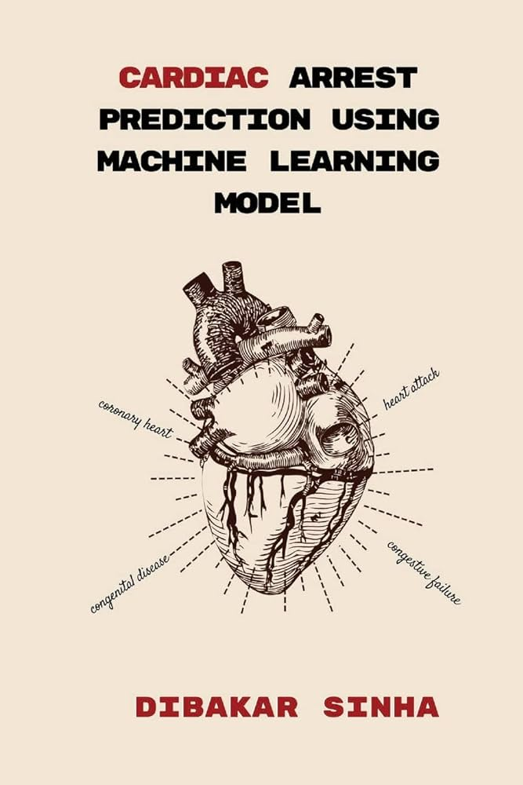
Data Analysis on Heart Disease Prediction Using Machine learning Algorithms
6500CSMM – Project
Presented by – Khaing Khant Kyaw
Supervised by- Dr. Yuzana Win
23th May 2024
Defense
1
Notes:
Good morning Ladies and Gentlemen. Welcome to the journey of data analysis on heart disease prediction with machine learning algorithms. My name is Khaing Khant Kyaw and I will start my presentation starting from now.

Slide 2
Agenda
Introduction
01
Aims & Goals
02
System Architecture
03
Experimental Result
04
Heart Disease Prediction Web App
05
Key Findings and Future work
06
2
Notes:
First I will start with introduction. I am here to shed light on why heart disease deserves our utmost care and attention, not just in medical realm but also in our daily lives. I will also be discussing contribution my project makes to real world in combating this issue. Next, I will carry on addressing Aims and Goals. In this category, I will discuss which aims and goals are aimed to achieve for this project. The next part is system architecture. This part involved flow chart. And We will carry on experimental result. In this category, I will be explaining detail implementation steps and accuracy score for each machine learning algorithms. For next category, deploying heart disease prediction web app on local host is explained thoroughly with demo photos and last but not the least key finding which new knowledge and experience I gain from this project and future work where project can be improve or develop further by doing further extensions.

Slide 3

Introduction
3

Slide 4
Why heart disease?
4
Notes:
So why heart disease??

Slide 5
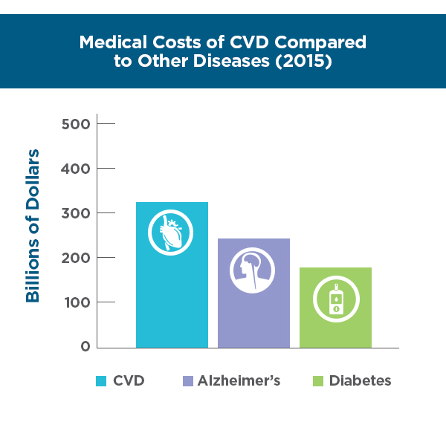
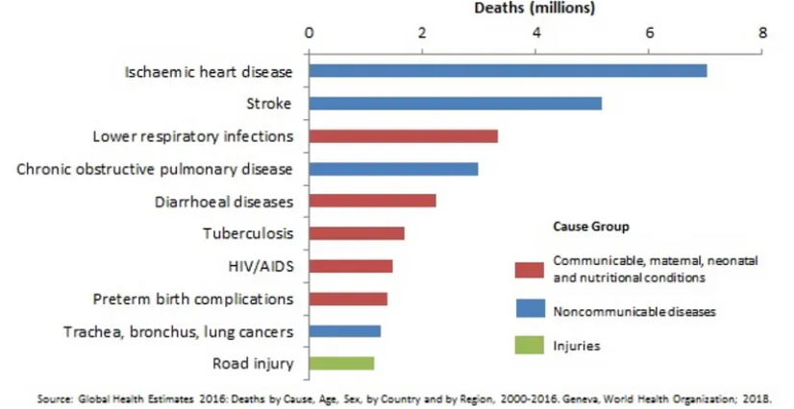
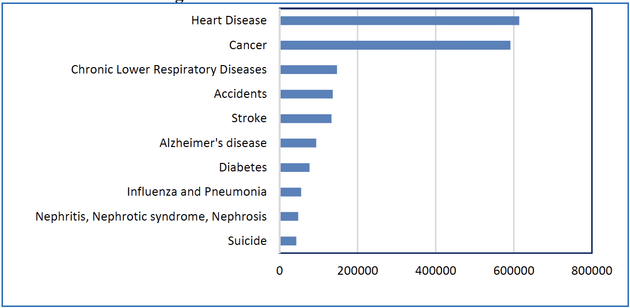
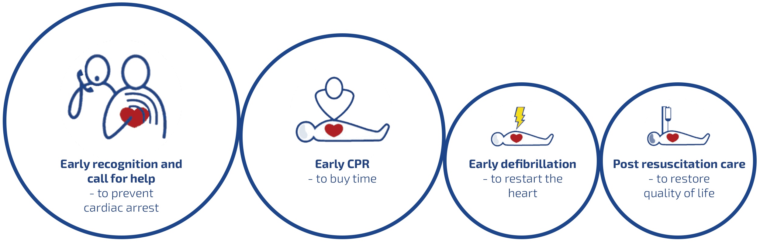
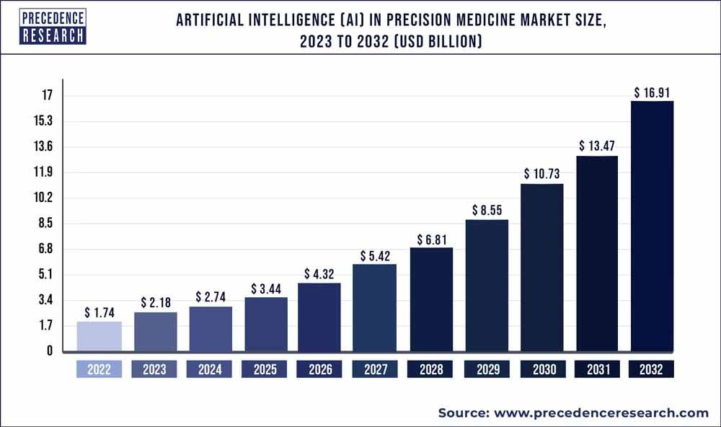

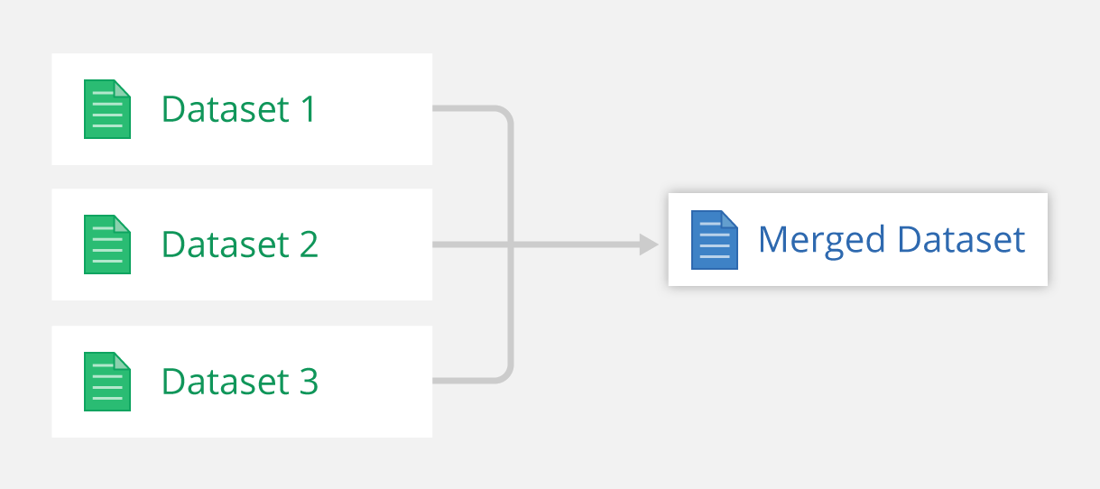
Heart Disease is leading cause of death since 2000
Killing over 600,000 people each year from illness related to cardiovascular disease
Economic burden of heart disease treatment is nearly $300 billion per year,
Early detection is pivotal for effective intervention
By combining several datasets , comprehensive dataset that covers wide variety of potential heart disease predictors is built
Number of machine learning algorithms are investigated to choose which algorithm would be best suit and by using cutting edge technology increase the accuracy score
By giving insights into effective modeling to help medical professionals
5
Notes:
Heart Disease has been leading cause of death with over 6 million since 2000.
Claiming over 600,000 lives annually between 2000 and 2016 according to report by WHO which is released in 2018.
Even when we compare with other disease, economic burden of heart disease is incomparable with over 300 billion per year.
As we all know, early detection is pivotal for heart disease prediction.
Through emerging multiple datasets, a dataset encompassing a diverse array of potential heart disease predictor is constructed.
Extensive investigation into a range of machine learning algorithm is conducted to identify most suitable and cutting edge algorithms for heart disease prediction
by giving effective insights to medical professions, this project contribution potential can be enormous.

Slide 6
Domain
Machine Learning
Core domain in this project
Grid Search Cross Validation
Algorithm Selection
Model Training and Evaluation
Presenting Accuracy result
8

Slide 7
Domain
Machine Learning
Data Analysis
Core domain in this project
Grid Search Cross Validation
Algorithm Selection
Model Training and Evaluation
Presenting Accuracy result
Preparing and Cleansing Datasets
Evaluating model with different algorithms
Evaluating model with different train, test splits
9

Slide 8
Domain
Machine Learning
Data Analysis
Web Development
Core domain in this project
Grid Search Cross Validation
Algorithm Selection
Model Training and Evaluation
Presenting Accuracy result
Preparing and Cleansing Datasets
Evaluating model with different algorithms
Evaluating model with different train, test splits
Upload on Web using Flask
Deploy the best performing machine learning model
Enhance accessibility and practicality for potential user
10

Slide 9

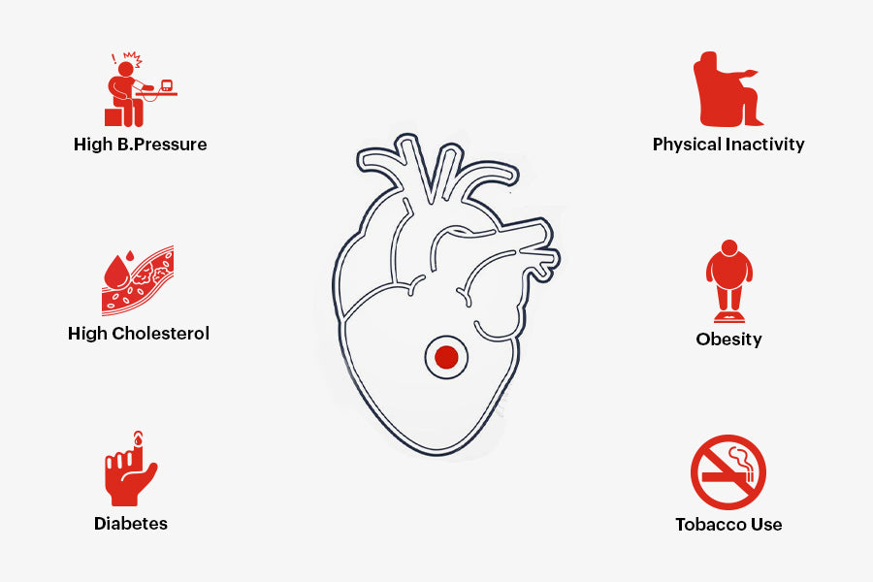
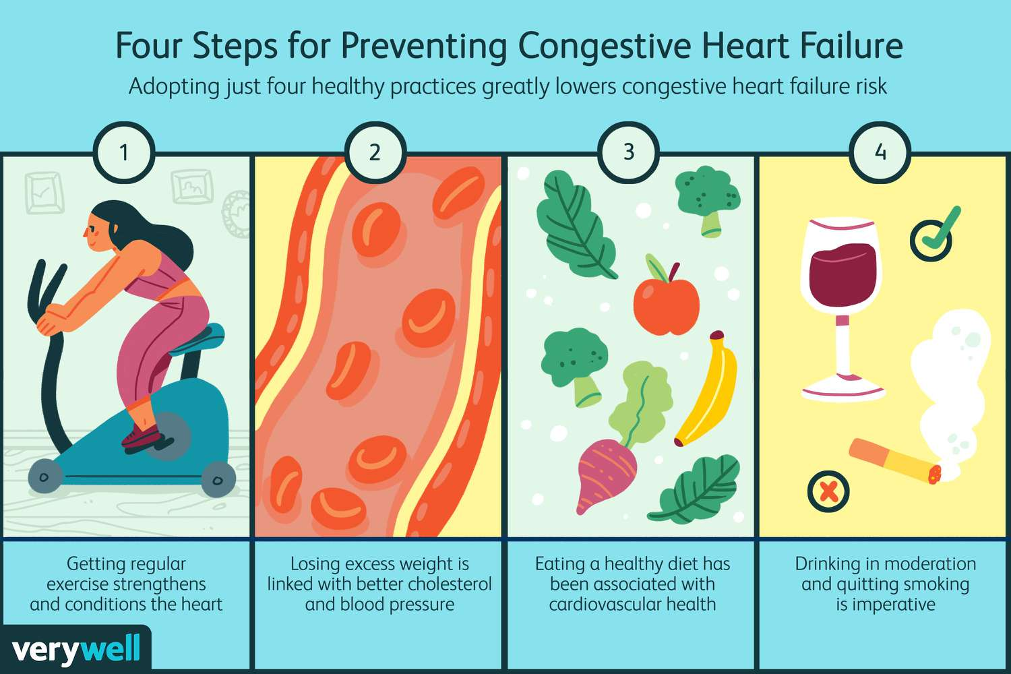


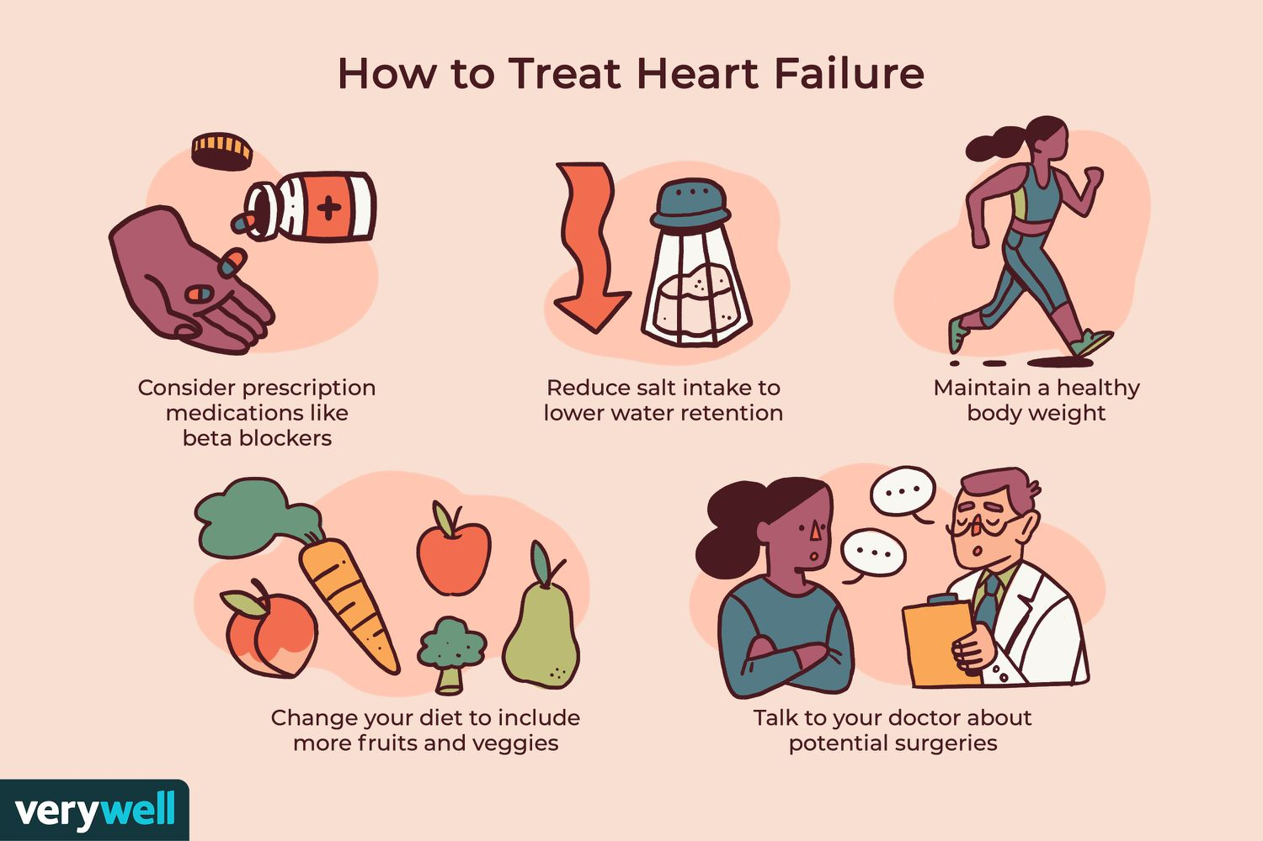
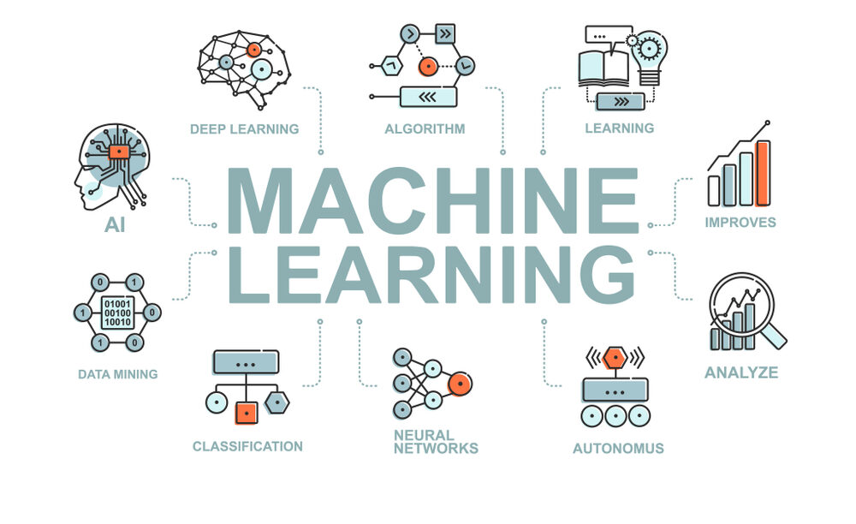
Aims & Goals
Reducing Mortality Rates with help of machine learning
Empowering Patients
Reducing Healthcare Costs
Enhancing Public Health
6
Notes:
My project scalable solution for heart disease prediction and management contribute to broader public health initiatives through targeted interventions, awareness campaigns and explain which should be do or not to strengthen your immunity against heart disease.

Slide 10
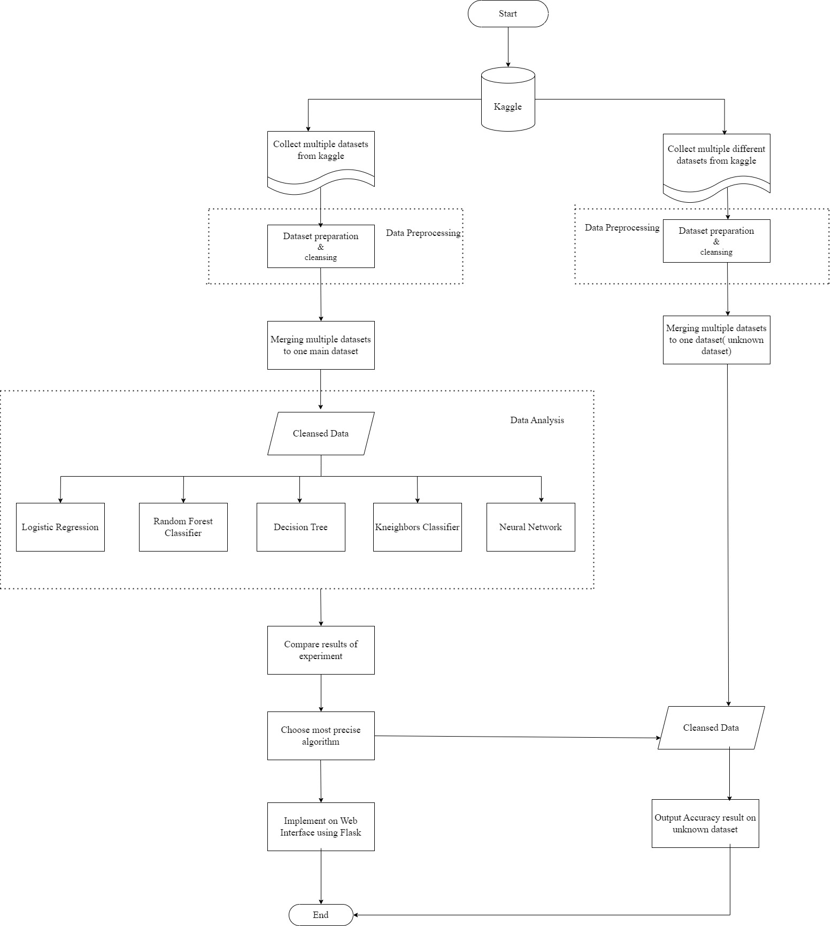
System Architecture
Flow chart
11
Notes:
Next I will carry on explaining system architecture which include flow chart,
First I browse multiple website which I can find source dataset, after careful investigation find out Kaggle has the best suit dataset.
I collect multiple datasets and start data preprocessing and cleansing which I will explaining in later slide.
After making sure the data is cleansed, merging multiple dataset into one main dataset which I will be using throughout project.
After gaining cleansed main dataset, I train multiple machine algorithms on dataset with different train test ration and after gaining result, I compare results of experiments.
Choose most precise algorithms. Now let me explain other side. In this part, I collect multiple different datasets from Kaggle and data preprocess and cleans them as I do in main dataset.
I try merging in one dataset as one before but this time it is named unknown dataset or testing dataset.
And from among algorithms, I get model with most precise algorithm and test it on unknown dataset for knowledge of accuracy result of unknown dataset.
With most precise algorithms I implement on web interface using flask which I will be testing at the end of this power point.
That conclude flow chart of the project.

Slide 11
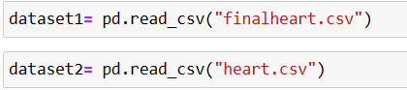
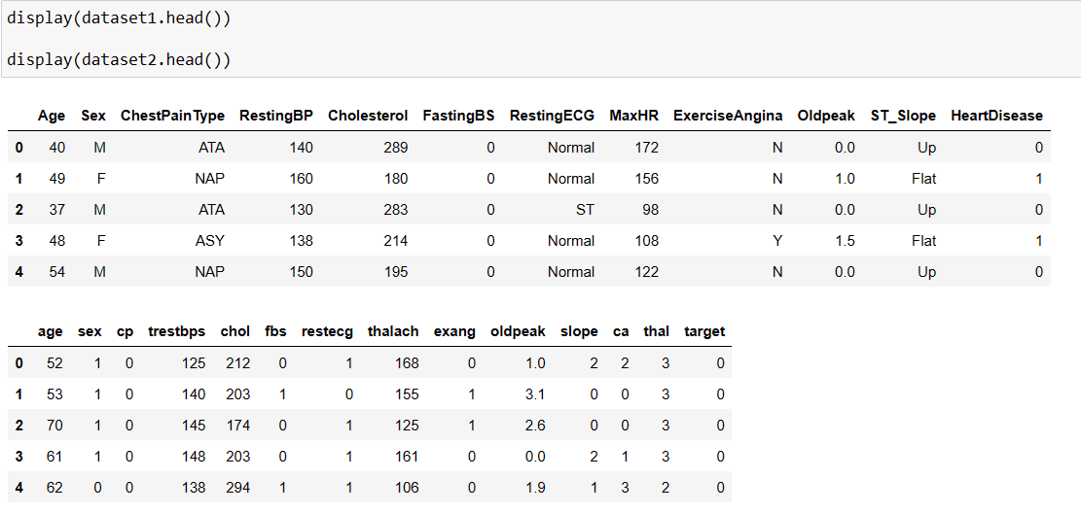
Experimental Result
Data Set Merging and Preprocessing
13
Notes:
Two dataset is imported first and name dataset 1 and dataset 2 as we all can see.
When we display both dataset and compare, as we all can see the columns names are different and row components are also not the same.

Slide 12
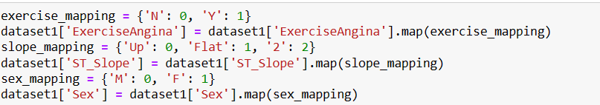
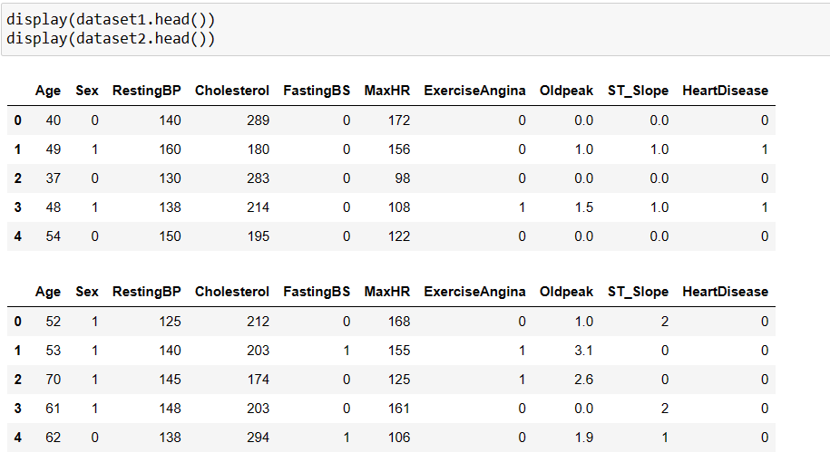
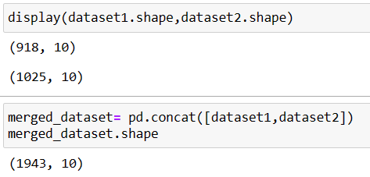
14
Notes:
To make data values equal, I do mapping between two datasets and rename columns name which are not the same.
After cleansing, as we all can see the columns name are identical now which is suitable for merging data.
I double check both data set shape and finally merge them and check again.

Slide 13
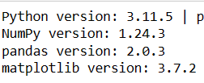
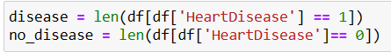
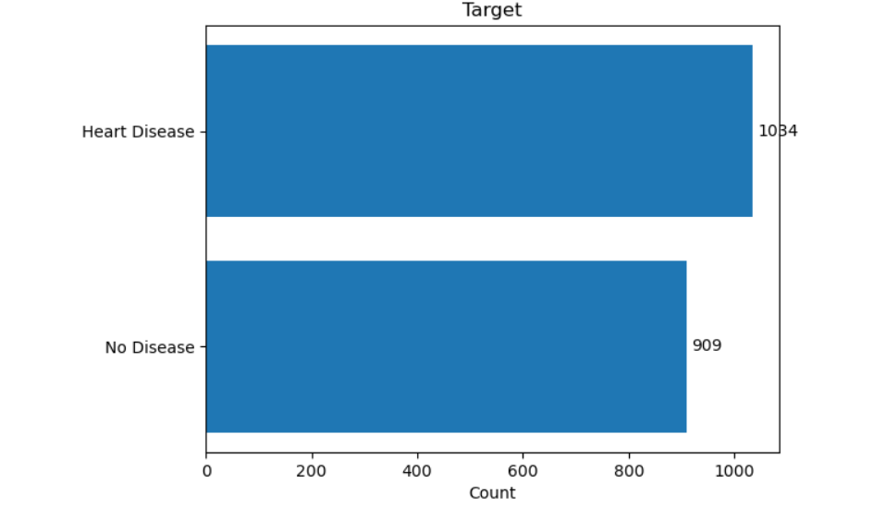
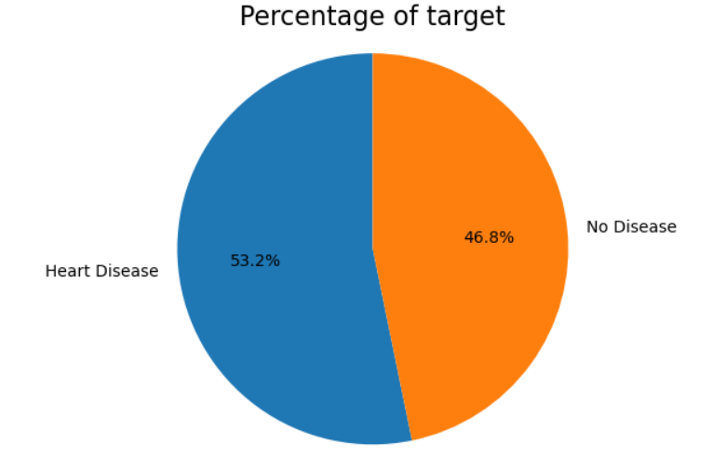
Model Training And Evaluation
15
Notes:
For version, I provide figure here detailing exact version I used for my project.
To prove my datas are not biased, I illustrated with two figures using metplolib. As we can clearly see, the percentage are 53 percent in favor of heart disease and 47 percent in favor of no disease meaning data set is not biased and suitable for training testing data.

Slide 14
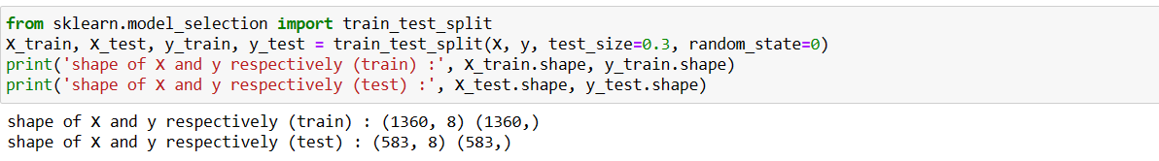
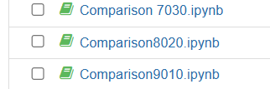
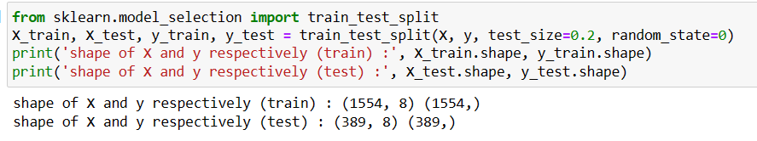
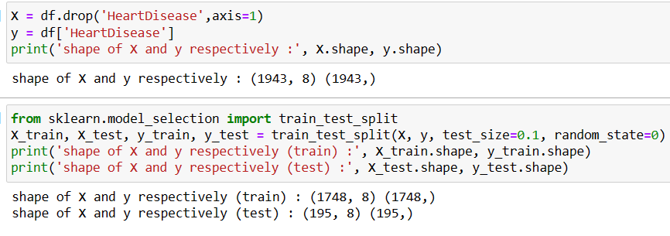
16
Notes:
As I said earlier, I split comparison 90 train 10 test here and 80 20 here and 70 30 here as shown.

Slide 15
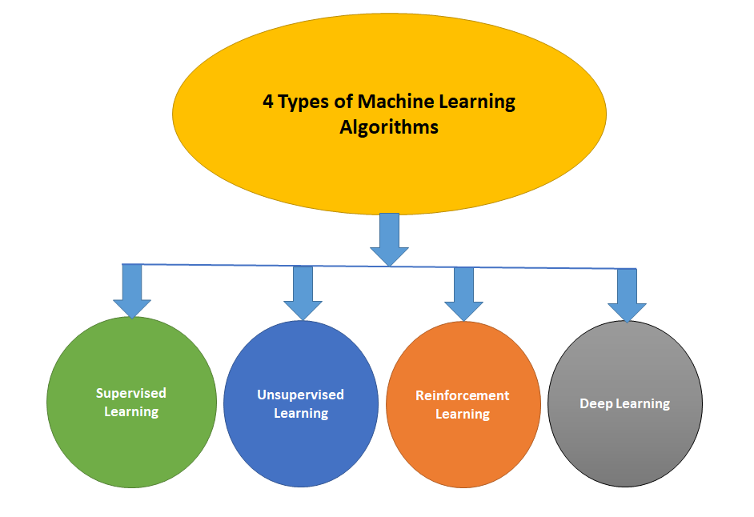


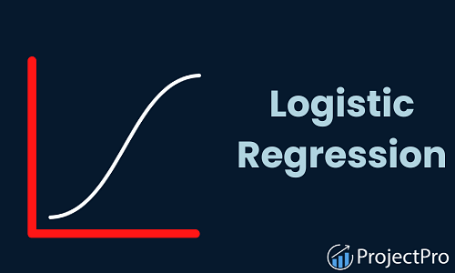
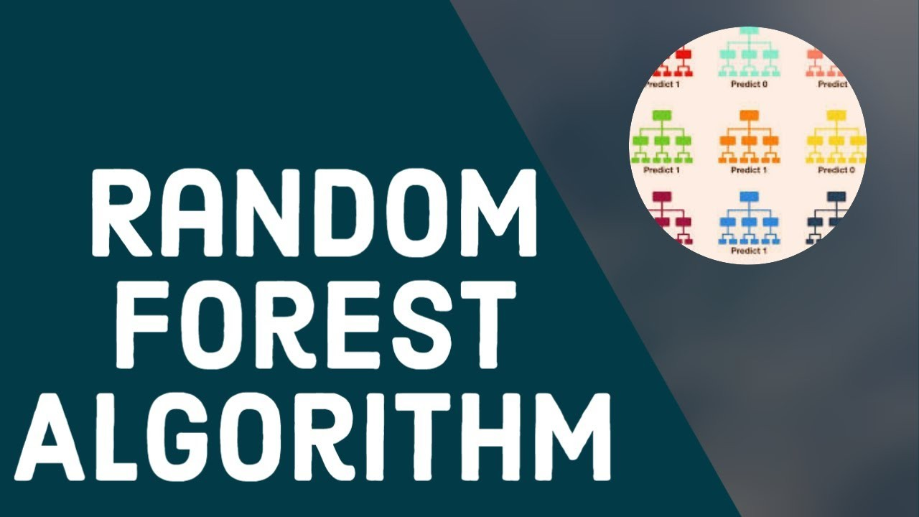
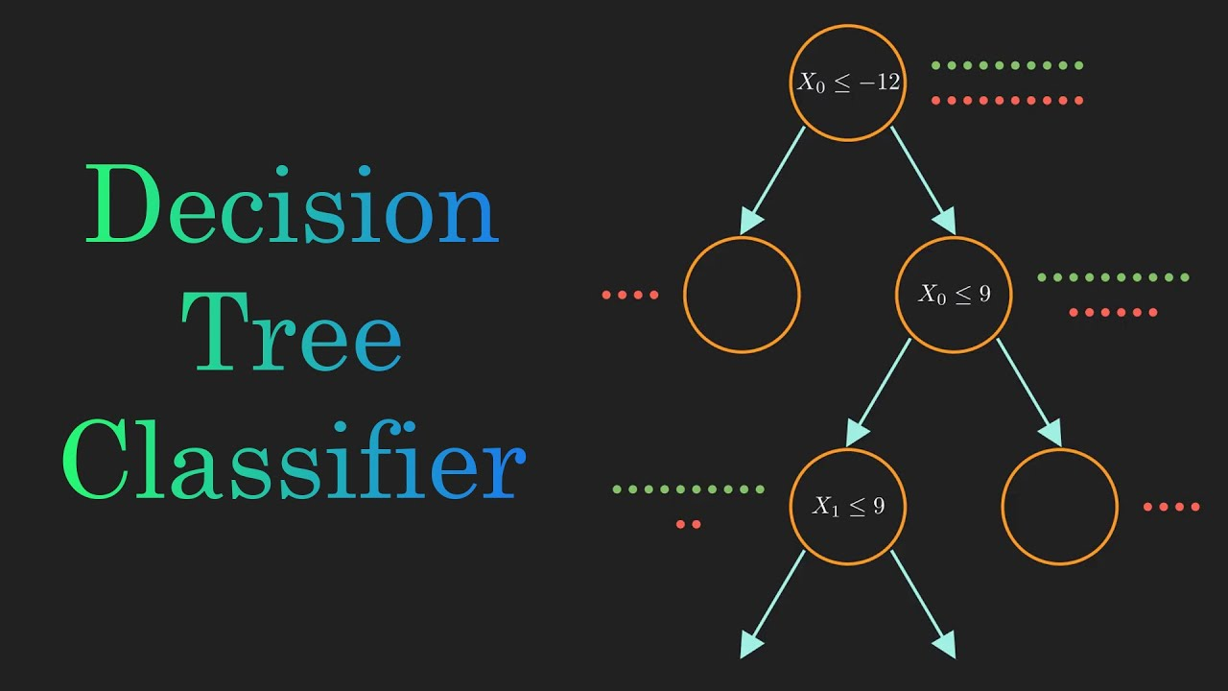

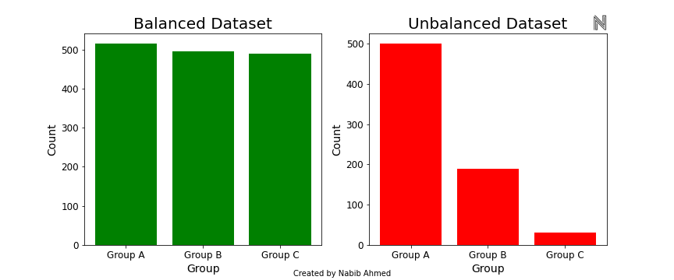
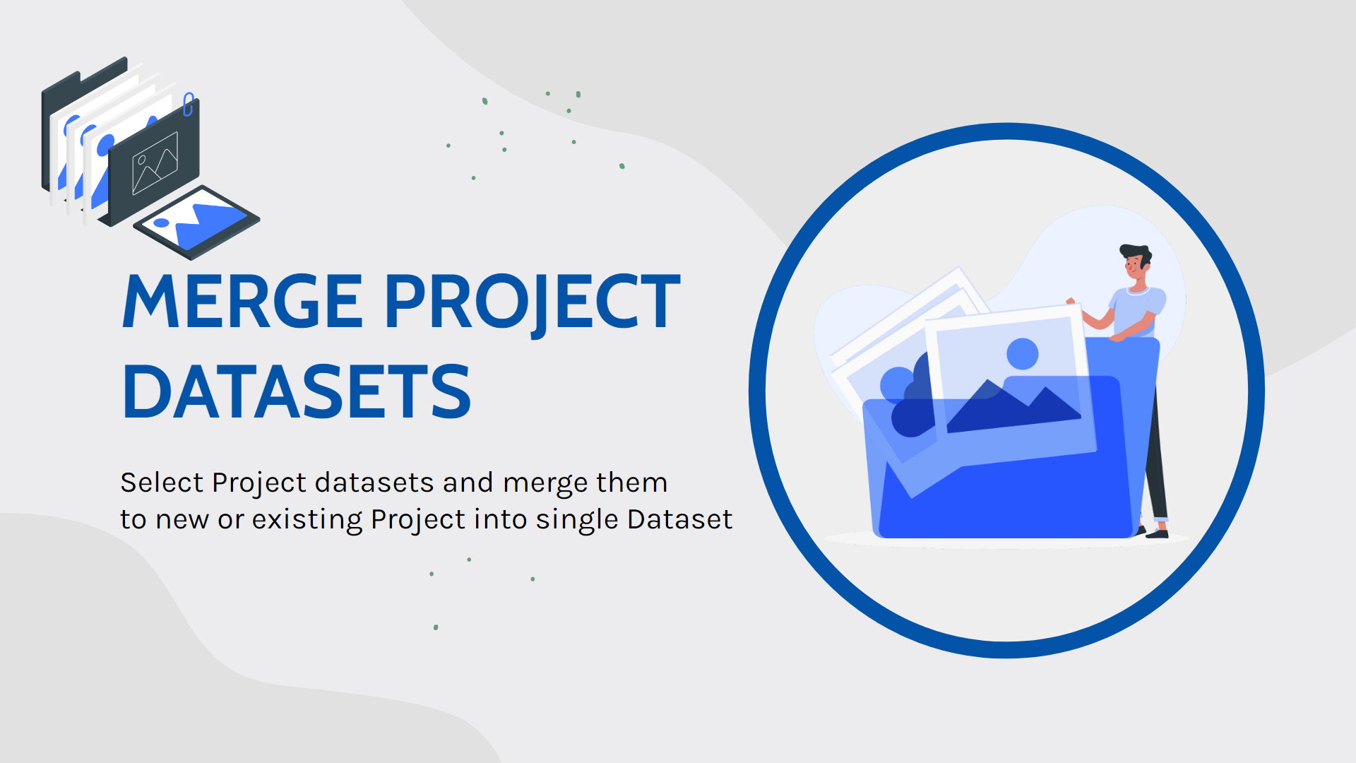
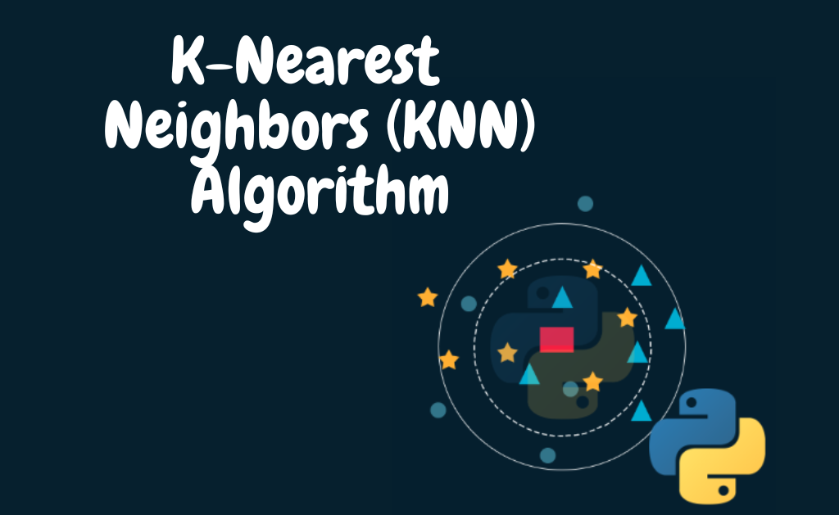

Proposed Methods
Types of Machine Learning models and machine learning algorithms used in this project
Utilization of advanced diverse dataset and advanced modeling techniques
Deployment of best performing model on local host as web app
7
Notes:
I will continue to talk about types of machine learning models and machine learning algorithms used in this project.There are 4 types of machine learning algorithms. As we all see, supervised learning, unsupervised learning, reinforcement learning and deep learning. For this project, I used 5 machine learning algorithms. Which are logistic regression, random forest classifier, decision tree, knear neighbor classifier and neural network which all are under supervise machine learning model.
we dive into the utilization of advanced diverse datasets and modeling techniques. We emphasize the significance of data quality and diversity in machine learning projects, detailing our process of collecting and curating datasets relevant to heart disease prediction. We highlight the inclusion of various potential predictors and discuss how advanced modeling techniques, such as feature engineering and ensemble methods, were employed to extract meaningful insights from the data and enhance model performance.
Following this, we transition to the deployment phase, where we focus on making our predictive model accessible and user-friendly. We elucidate the development process of a web application using frameworks like Flask or Django, stressing the importance of creating an intuitive interface. We explain how the best-performing model is seamlessly integrated into the web application, allowing users to input data and receive predictions conveniently. Furthermore, we underscore the significance of deploying the model on localhost, enabling easy access for local users without the need for external hosting services.

Slide 16
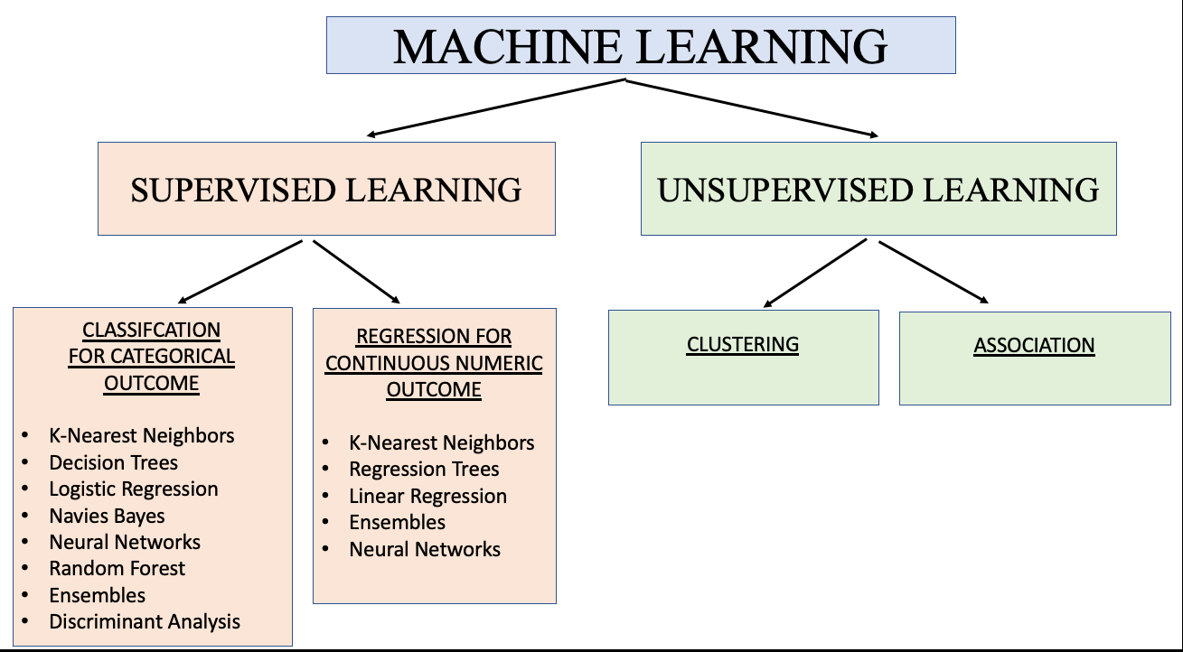
Proposed Methods
Mercury is the closest planet to the Sun and the smallest one in our Solar System—it’s only a bit larger than our Moon. The planet’s name has nothing to do with the liquid metal, since it was named after the Roman messenger god
12

Slide 17
Proposed Methods
Decision Tree (Supervised Learning)
Objective: Provide interpretable decision-making processes
.
Outcome: Can suffer from overfitting and lack of generalization on complex datasets, but effective for smaller datasets with clear feature splits.
Logistic Regression (Supervised Learning)
Objective: Classify data points into discrete categories
Outcome: A foundational model for classification tasks, though performance may vary based on data complexity and feature relationships.
K-Nearest Neighbors (Supervised Learning)
Objective: Utilize instance-based learning for classification.
Outcome: Performance highly dependent on the choice of 'k' and the distance metric, suitable for datasets with well-defined clusters and less effective for high-dimensional data.
Random Forest Classifier (Supervised Learning)
Objective: Improve classification accuracy and robustness.
Outcome: Generally effective due to ensemble learning, capable of handling large datasets with high dimensionality and providing feature importance insights.
Neural Network (Supervised Learning)
Objective: Leverage deep learning for complex pattern recognition.
Outcome: Offers high flexibility and capability to learn intricate relationships in data, but requires large amounts of data and computational resources, prone to overfitting without proper regularization techniques.
17
Notes:
I'll walk you through a comparative analysis of various supervised learning algorithms commonly used in heart disease prediction tasks.
Firstly, Logistic Regression serves as a foundational model, focusing on classifying data points into discrete categories. While it's a reliable choice, its performance may vary based on the complexity of the dataset and the relationships between features.
Next, we'll explore the Random Forest Classifier, which emerges as the most suitable algorithm for our heart disease prediction project. This algorithm aims to improve classification accuracy and robustness through ensemble learning. Thanks to its ensemble approach, it's generally effective, especially with large datasets and high dimensionality, while also providing insights into feature importance, crucial for understanding the underlying factors contributing to heart disease risk.
Moving on to Decision Trees, these models provide interpretable decision-making processes by recursively partitioning data based on feature splits. While effective for smaller datasets with clear feature splits, they can struggle with overfitting and lack of generalization on more complex datasets.
K-Nearest Neighbors (KNN) follows, utilizing instance-based learning for classification. Its performance heavily relies on the choice of 'k' and the distance metric used, making it suitable for datasets with well-defined clusters but less effective for high-dimensional data.
Lastly, we'll discuss Neural Networks, leveraging deep learning for complex pattern recognition. Despite their high flexibility and capability to learn intricate relationships, they demand substantial data and computational resources. Without proper regularization, they may overfit, compromising their performance.
Throughout the presentation, we'll delve into the strengths, weaknesses, and typical use cases of each algorithm, ultimately emphasizing the Random Forest Classifier as the optimal choice for our heart disease prediction project.

Slide 18
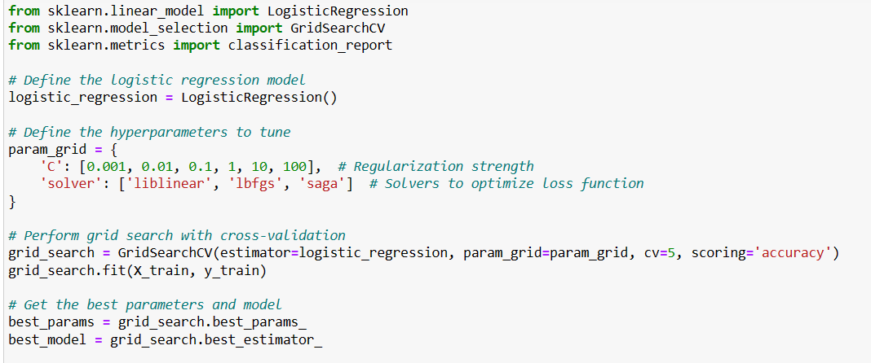
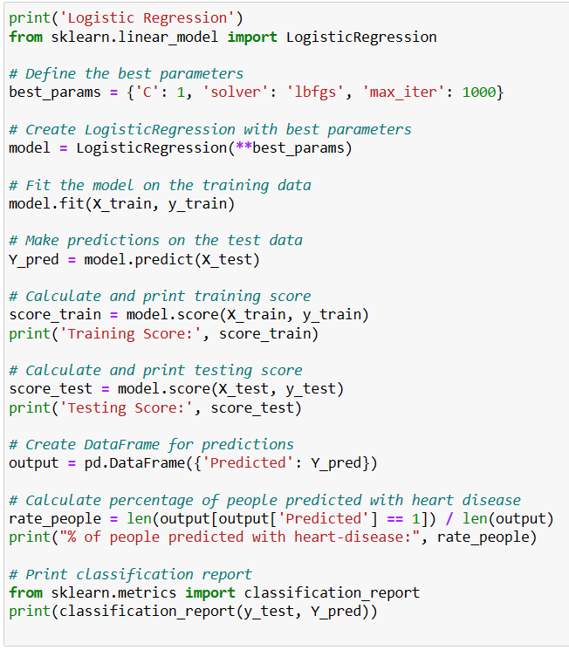
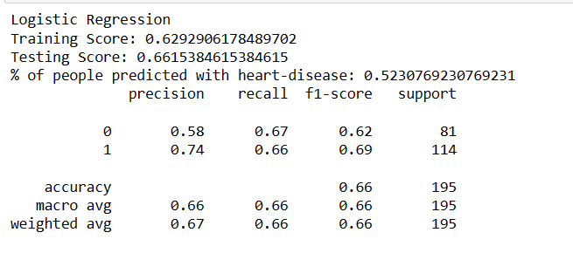
18
Notes:
First I use grid search cross validation to show best parameter for logistic regression and train model as shown and finally I get training and testing accuracy result.

Slide 19
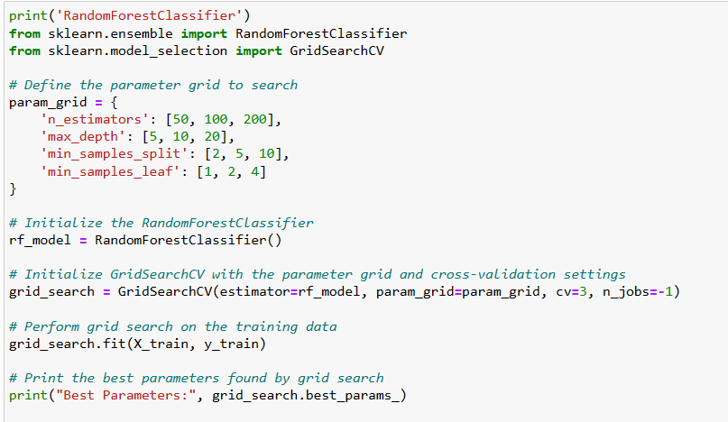
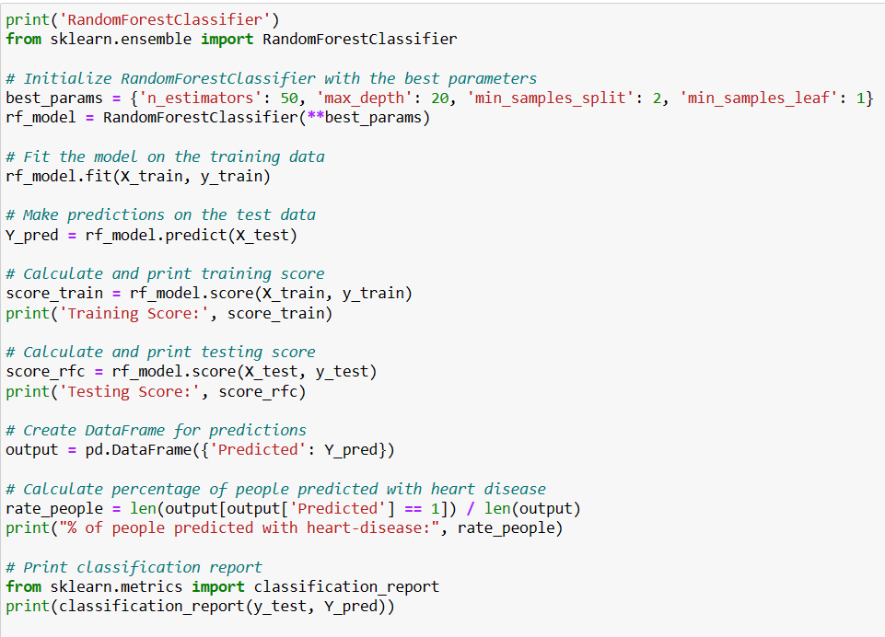
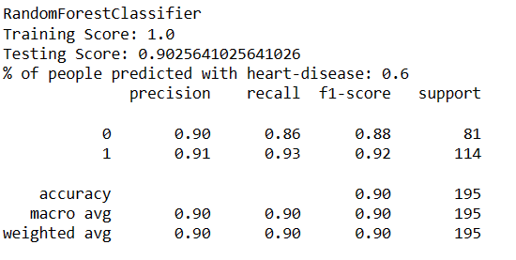
19
Notes:
I use grid search cross validation to show best parameter for random forest classifier and train model as shown and finally I get training and testing accuracy result.

Slide 20
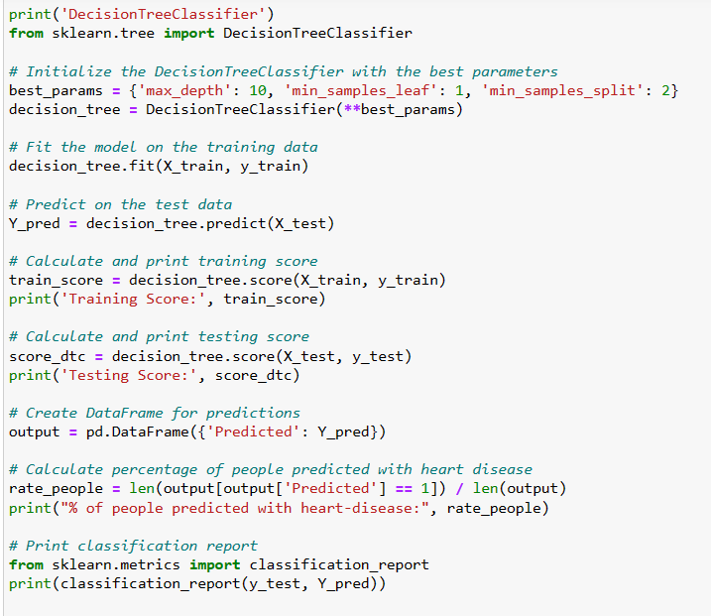
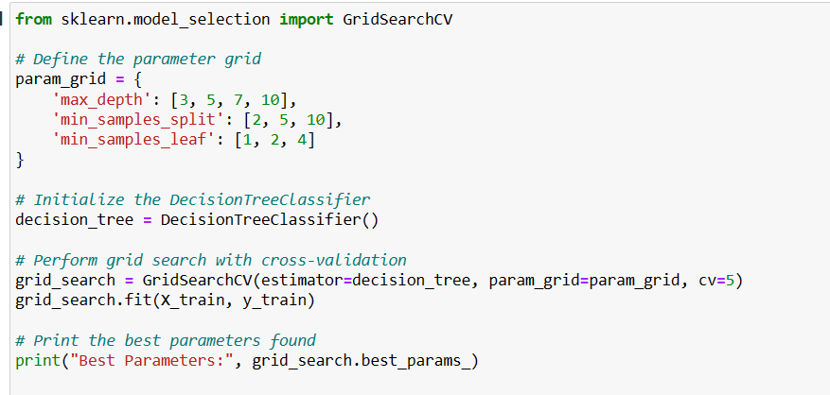
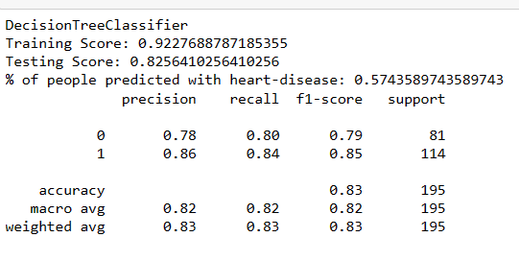
20
Notes:
I also use grid search cross validation to show best parameter for decision tree classifier and train model as shown and finally I get training and testing accuracy result.

Slide 21
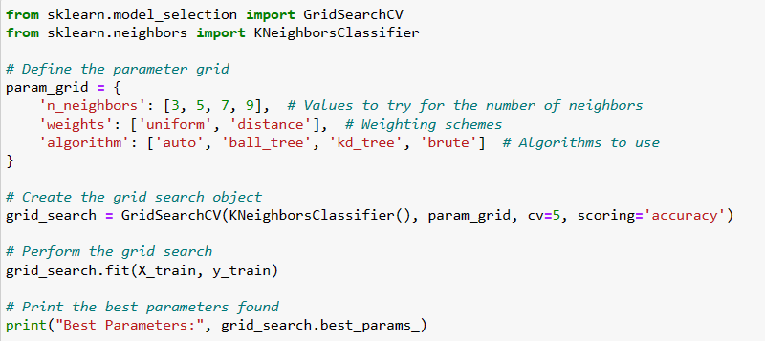
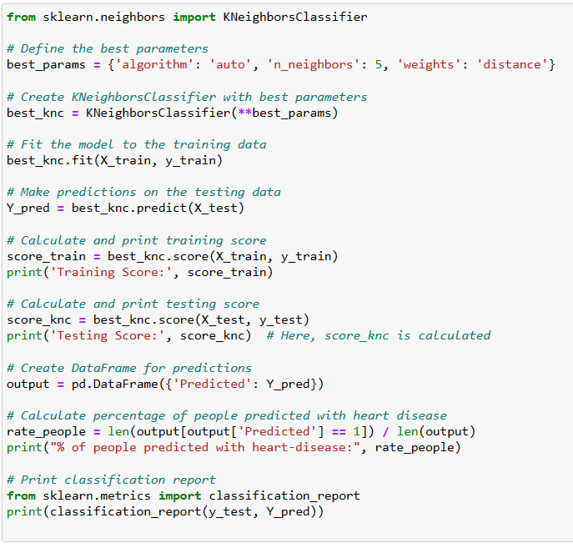
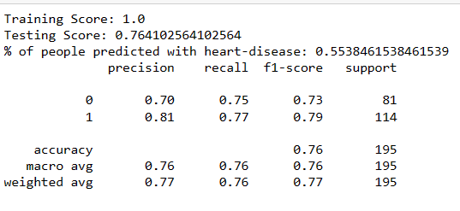
21
Notes:
I do the same for knearest neighbor classifier and get the training and testing accuracy result for it too.

Slide 22
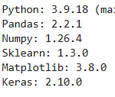
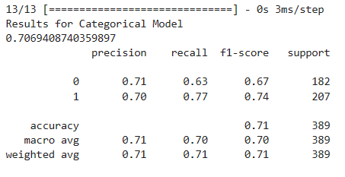
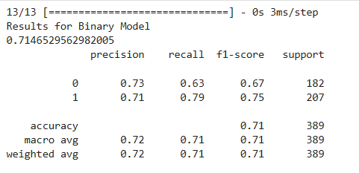

Slide 23
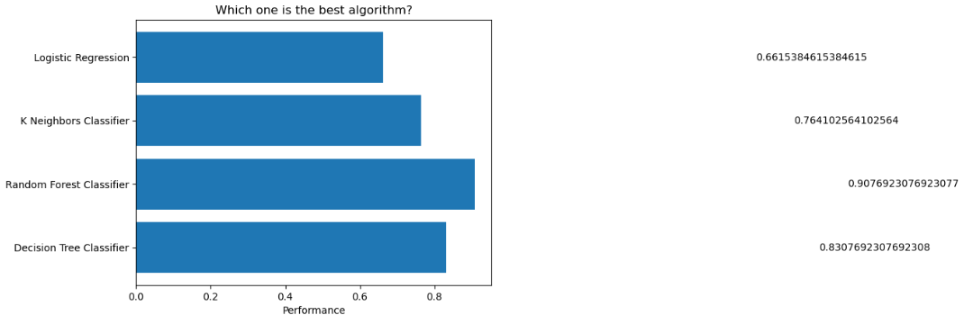
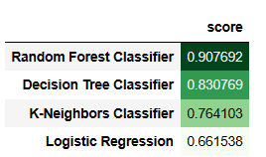




90/10 Split
70/30 Split
80/20 Split
22
Notes:
To be more clear and detail, I illustrate 90 10 split and compare machine learning algorithms to display clearly which algorithm and which split come out as the best one. As we all can see, in all 3 train test split random forest classifier come out as the best algorithm.

Slide 24
Comparing Accuracy
70/30 Split
90/10 Split
80/10 Split
23
Notes:
I put them side by side so we can get more detail view of accuracy for each train test split. Among 3 train test as we can see

Slide 25
Highest Accuracy Model
90/10 Split
24
Notes:
90 10 split of random forest classifier come out as the best one.

Slide 26

Highest Accuracy Model
90/10 Split
Extracting pickle file from random forest classifier algorithm as it has the highest accuracy
24

Slide 27


Testing on unknown Dataset
Creating unknown dataset
25
Notes:
Same as main data set I try merging cleansing and preprocessing multiple datasets and create unknown dataset. In this red box, I just highlight the columns are not identical so that we can know these are two different datasets with different columns name and values.

Slide 28

Testing on unknown Dataset
Creating unknown dataset
25

Slide 29



26
Notes:
And then I insert testing data set in unknown testing file. I also export model out of most precise machine learning algorithm and test it on testing dataset. As we can see here, the accuracy come out as 0.5925. As the data is completely unknown to train data, the accuracy is reduced significantly.

Slide 30



Heart Disease Prediction Web App
Web Framework
Programming Language
Styling
Flask enables rapid development and deployment of web applications thanks to its straightforward structure and user-friendly interface.
The vast collection of libraries available in Python empowers us to utilize a diverse array of robust packages and modules for our project.
The rich assortment of components in CSS enables us to craft visually attractive and uniform user interfaces that seamlessly adapt to various devices.
27
Notes:
This time we'll explore Flask, a web framework known for its rapid development and deployment capabilities. With its lightweight structure and intuitive design, Flask streamlines the development process, enabling quick setup and straightforward navigation for developers. Its user-friendly interface facilitates smooth interactions for both developers and end-users, making it an efficient choice for building scalable web applications with ease.
Python's extensive library ecosystem empowers us to leverage a diverse range of powerful packages and modules for our project. With a vast collection of libraries at our disposal, we can access specialized tools and functionalities to enhance the efficiency and effectiveness of our work. This rich ecosystem enables us to seamlessly integrate advanced features and capabilities into our project, accelerating development and unlocking new possibilities for innovation and experimentation.
The diverse range of components available in CSS empowers us to create visually appealing and consistent user interfaces that seamlessly adapt to different devices. With a rich assortment of features at our disposal, we can easily customize and style elements to enhance the overall design and usability of our web applications. This flexibility enables us to deliver engaging and responsive user experiences across desktops, tablets, and mobile devices, ensuring a seamless interaction regardless of the platform.

Slide 31


Heart Disease Prediction Web App
User-Friendly Interface
User-Centric
Mobile Responsive
Visual Enhancements for Accessibility
28
Notes:
a user-friendly interface refers to a website or web application design that is intuitive, easy to navigate, and visually appealing. It focuses on providing a seamless experience for users, ensuring they can easily find what they need and complete tasks without confusion or frustration.
User-centric web development emphasizes creating interfaces that prioritize user needs and preferences. These interfaces are intuitive, accessible, and focus on providing a seamless user experience. By centering design decisions around users, websites and applications become more engaging and satisfying to use.
designing interfaces that are inclusive and user-friendly for individuals with diverse needs. This includes ensuring clear contrast, legible fonts,

Slide 32


Demo: Testing with Trained Data
No Heart Disease
Heart Disease
29

Slide 33


Demo: Testing with Unseen Data
No Heart Disease
Heart Disease
30

Slide 34

Key Findings
Effective Model Selection.
Utilization of Diverse Data Set
Precise Prediction
Practical Deployment
31
Notes:
Effective Model Selection: I learned the importance of carefully evaluating and selecting the appropriate machine learning algorithms for specific tasks, ensuring optimal performance and accuracy in predictive modeling.
Utilization of Diverse Datasets: I gained experience in integrating data from diverse sources and domains, understanding how this approach enriches the dataset and improves the reliability of predictive models.
Precise Prediction Techniques: Through hands-on experimentation with advanced modeling techniques and feature engineering, I honed my ability to achieve precise predictions, enabling proactive intervention and targeted strategies for risk management.
Practical Deployment Strategies: I learned how to deploy machine learning models in real-world scenarios, utilizing user-friendly interfaces and accessible platforms to ensure practical usage by stakeholders such as healthcare professionals and individuals.

Slide 35
Future Work and Further Extensions
Enhanced Predictive Performance
Incorporating advanced machine learning techniques improves the accuracy and reliability of heart disease prediction model.
Real-Time Monitoring and Feedback Systems
Develop real-time monitoring and feedback systems that continuously update predictions based on incoming patient data, enabling proactive interventions and personalized treatment strategies.
Robustness and Generalizability
Addressing imbalanced data and conducting external validation ensures the robustness and generalizability of our predictive model across diverse patient populations.
32
Notes:
Enhanced Predictive Performance: Incorporating advanced machine learning techniques can significantly enhance the accuracy and reliability of our heart disease prediction model. Exploring methods such as deep learning architectures or ensemble learning approaches may further improve predictive performance.
Real-Time Monitoring and Feedback Systems: Developing real-time monitoring and feedback systems will enable continuous updates to predictions based on incoming patient data. Implementing such systems allows for proactive interventions and personalized treatment strategies, ultimately improving patient outcomes and reducing the risk of adverse events.
Robustness and Generalizability: Addressing challenges such as imbalanced data and conducting external validation studies are crucial steps to ensure the robustness and generalizability of our predictive model across diverse patient populations. By validating the model's performance on independent datasets and addressing biases, we can increase confidence in its reliability and applicability in real-world healthcare settings.

Slide 36


Thank you.
SUPERVISOR
Dr. Yuzana Win
Auston University
6500CSMM - PROJECT
Presentation by
Khaing Khant Kyaw
Project
23th May 2024
33

Slide 37
Ready to Test the App? Try it out, assess it, and embrace its potential! Heart Disease Prediction Web App
SUPERVISOR
Dr. Yuzana Win
Auston University
6500CSMM - PROJECT
Presentation by
Khaing Khant Kyaw
Project
23th May 2024
35

